Slide 1

Bringing Academics and Practitioners Together to Create and Share Knowledge on the Built Environment
Town+Gown Experience in
Applied Built Environment Research
Terri Matthews, Director, Town+Gown

Slide 2
Objectives for Law School Consortium Meeting
Build a consortium of cities and law schools to work together on developing regulatory templates and processes, with law schools bringing special knowledge, skills, objectivity, and thus added credibility to such teams to help shape better environments for fostering innovation and entrepreneurship by addressing such challenges as:
Developing well-balanced regulation of the evolving “sharing” (or “platform”) economy operations
Improving and streamlining permitting and licensing processes
Creating, testing and implementing technology-based approaches to addressing other municipal-level challenges
Assisting with the development of appropriate policies on the collection, use and sharing of data by cities
Developing a Law School Consortium

Slide 3
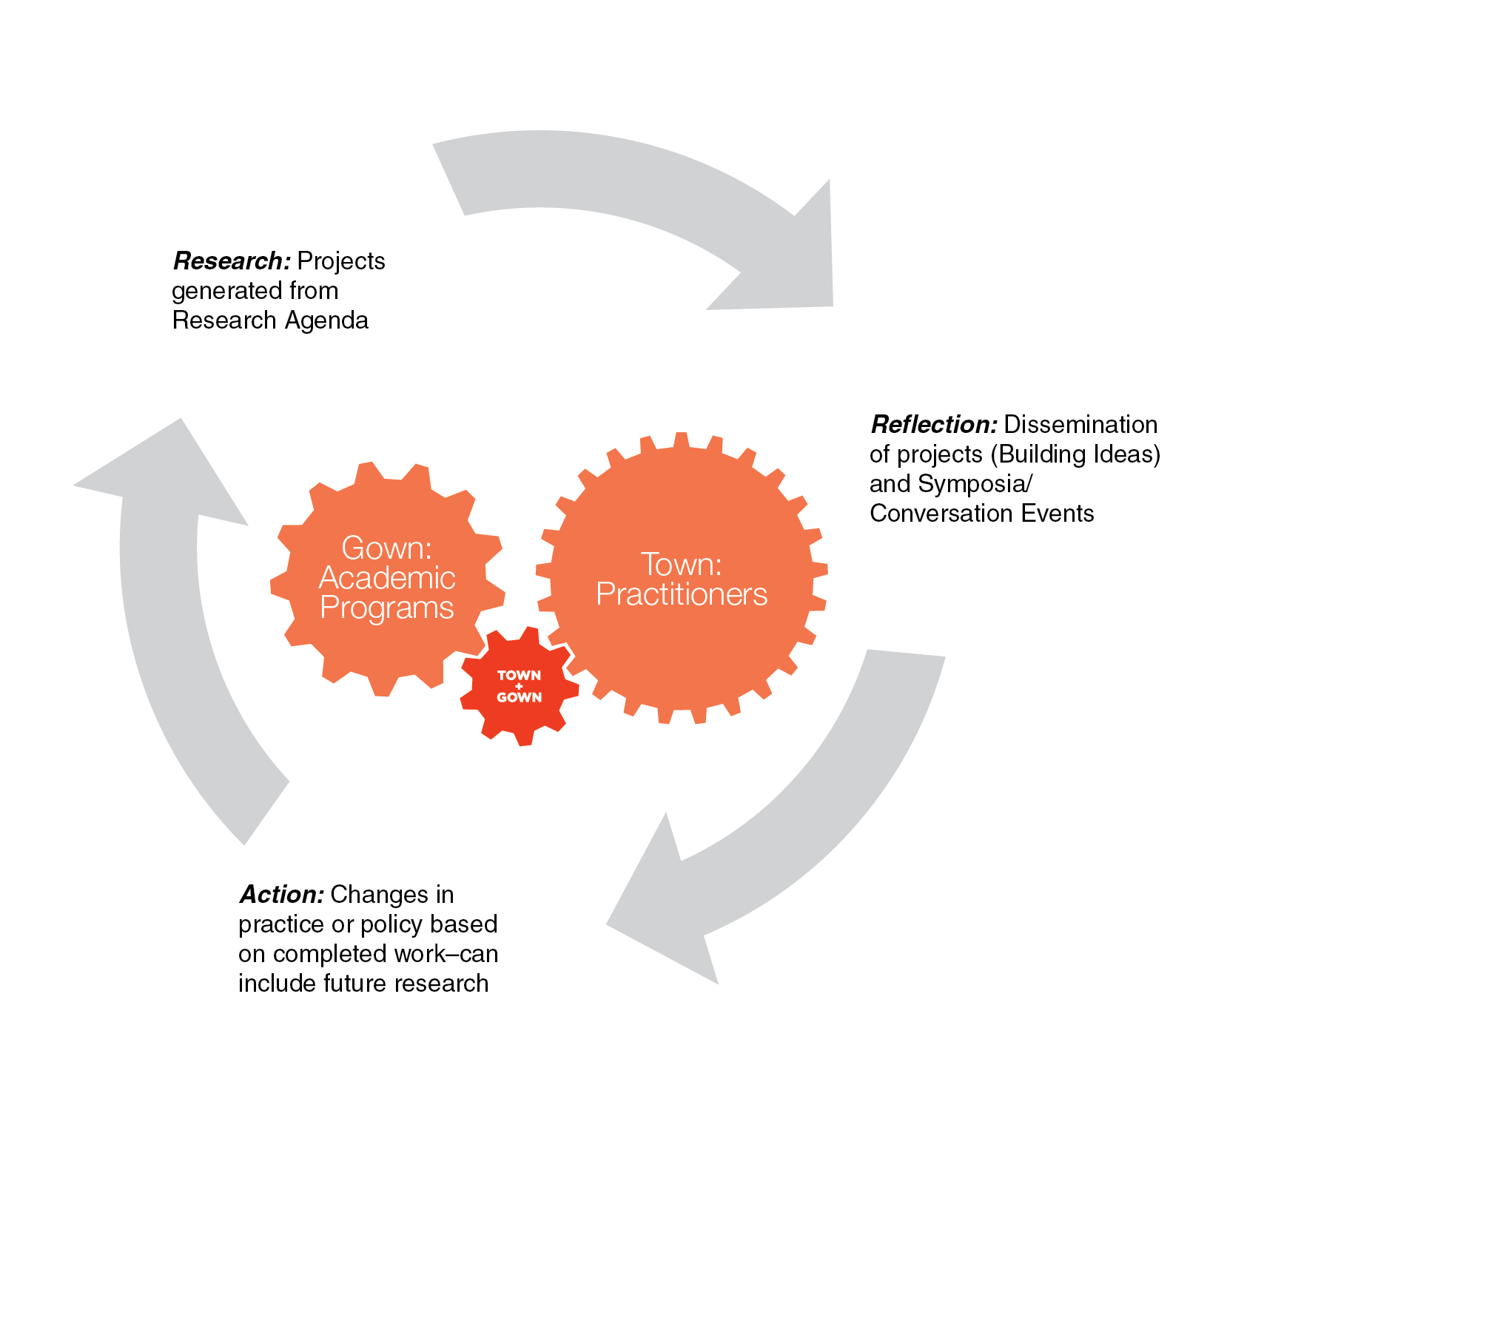
Town+Gown: Systemic Action Research
Action research: “a comparative research on the conditions and effects of various forms of social action and research leading to social action” that uses “a spiral of steps, each of which is composed of a circle of planning, action and fact-finding about the result of the action”.
Kurt Lewin, Action Research and Minority Problems, Journal of Social Issues (1946)
Systemic Action Research

Slide 4
Town+Gown Supports Practictioner and Academic Partnerships
Physical built environment as a laboratory for interdisciplinary applied research projects.
Resources and services link academics and practitioners within government and within the private sector on individual applied research projects to increase overall applied research in the built environment.
Unresolved systemic dysfunctions continue to consistently reveal urgent issues on particular design and construction projects and in the regulatory environment.
Equals in knowledge creation via Town+Gown’s system-wide open source platform and shared space can analyze, document and discuss the underlying systemic causes of dysfunction, in real time and over time.
Long-term transformative systemic changes in practice and policy can proceed from ideas and analysis generated by completed projects and research results.
Partners in Knowledge Production

Slide 5
Interdisciplinary Field of
the Built Environment
Applied
Technology
Management
Applied
Sciences
Education
Social and
Creative Professions
Civil Eng
Architecture/Design
Mechanical Eng
Social Work
Accounting
Allied Design Fields
Law
Electrical Eng
Computer Science
Law
Hard
Soft
Economics
Psychology
Sociology
Physics
Geography
(Urban Planning)
Chemistry
Political Science
Natural
Sciences
Mathematics
History
Arts and
Humanities
Pure
Languages
Paul Chynoweth, The Built Environment Interdiscipline: A Theoretical Model for Decision Makers in Research and Teaching, Proceedings of the CIB Working Commission (W089)Building Education and Research Conference, Kowloon Sangri-La Hotel, Hong Kong, April 10-13, 2006.
Built Environment Disciplines

Slide 6
Legal Research Needs to “Go Native”: Oliver Williamson
“Transaction cost economics maintains that any issue that arises as or can be posed as a contracting problem can be examined to advantage in transaction cost economizing terms. Many issues, of which the make-or-buy decision (vertical integration) is one, arise directly as contracting problems. Many other issues that originally appear to lack contracting aspects turn out, upon examination, to possess them. (Thus whereas the oligopoly problem is commonly posed in market structure terms, reformulating it as a cartel problem quickly reveals its contracting structure.) The result is that the comparative contractual approach has wide reach and application to economic organization. If contract is really 'the seminal and classic subject of American legal education', possibly it has wide application to the law as well.
Yet Llewellyn's concept of contract-as-framework (supported by private ordering with courts reserved for ultimate appeal) has made only limited headway. American legal scholarship still relates mainly to the legal rules tradition: 'When American legal scholars speak of 'contracts' they typically do not mean contracts at all, but rather judicial decisions . . . involving disputes about contracts. Contracts themselves, the transactions that create them, and the business decision to comply with them, renegotiate them, or breach them have rarely surfaced in the academic study of [contract]’. * * *
My proposal for implementing the study of good order and workable arrangements is therefore as follows: examine each legal issue through the lens of comparative, farsighted contracting in which transaction cost economizing is featured; be relentlessly calculative; and, because all feasible forms of law and organization are flawed, work through the remediableness criterion.
That is a stringent prescription and some lawyer-economists may prefer greater latitude. Although that is understandable (and perhaps advisable),my recommendation would be to 'go native', which is easier said than done.
Thomas Kuhn speaks of the issues:
To translate a theory or world view into one's own language is not to make it one's own. For that one must go native, discover that one is thinking and working in, not simply translating out of, a language that was previously foreign, [which can be difficult]. . . . Many who first encountered, say, relativity or quantum mechanics in their middle years . . . [found themselves] fully persuaded of the new view but nevertheless unable to internalize it. (Kuhn, 1970, p. 204).”
From Oliver Williamson, Revisiting Legal Realism, Industrial and Corporate Change, Volume 5, No. 2, (1996), pp. 408-409, 414)
The Legal Discipline

Slide 7
Local Government as Anchor to Mitigate Problems of Recursive Collective Action
“As it happens, the mentioned feedback loops are themselves critically mediated through uncoordinated market decisions taken by multiple actors who face formidable collective action hurdles – hurdles that can prevent forward or hasten backward movement by endowing individual expectations with significant “self‐fulfilling prophecy” properties. These latter are the source of the aforementioned “feedback” effects – effects that can amplify optimism into dysfunctional bubble or boom, and pessimism into bust and protracted depression.
Because the hallmark of such “recursive collective action problems,” as we shall here call them, is their aggregating multiple individually rational decisions into collectively self-defeating and even self‐worsening outcomes, their solution requires the presence of a collective agent empowered to act on behalf of all parties to optimize joint outcomes.
* * *
For a number of reasons comprehensively elaborated below, many though not all of them rooted in the inherently state‐centered character of contract, commercial, trust and real property law under our constitutional order, the federal government and its instrumentalities are not now well suited to this task. At best they are but complementarily situated.
States and their instrumentalities – their municipalities in particular – are by contrast very well situated to play the appointed role.”
From Robert Hockett, It Takes a Village: Municipal Condemnation Proceedings and Public/Private Partnerships for Mortgage Loan Modification , Value Preservation and Economic Recovery, Cornell Law School Research Papers, No. 12-12, pp. 1-2..
Local Government as Consortium Anchor

Slide 8
Town+Gown: Two Components
Experiential Learning Component
Experimental learning programs, such as law clinics, studios, workshops, capstones, internships for credit, masters theses and Ph.D. dissertations, at any academic institution
Graduate and undergraduate classes at any academic institution
Funded Research Component via Academic Consortium Contract available to New York City and State agencies:
- Brooklyn Law School ** - Pace University *
- City University of New York * - Pratt Institute
- Drexel University ** - State University of New York *
- Fordham University * - The Cooper Union
- Manhattan College - The New School **
- New York Institute of Technology - Tufts University
- New York University *
** Participating In Law School Consortium Conversation
* Has a law school
Program Components

Slide 9
Town+Gown: The Roadway Research Projects
A series of Town+Gown’s systemic action research sets related to the roadway has been highly dependent on several strands of legal analysis that focused on the laws affecting the urban roadway, through which much of the “smart city” technology infrastructure must run.
The maze of complex public and private utility infrastructure, in New York City, is governed by 19th century municipal law of the public right of way, franchises and concessions and public finance that co-exist with multiple levels of more modern and continuing public utility regulation at three levels of government.
Ongoing related legal, urban planning and economic analyses supported and captured by Town+Gown in clearinghouse manner can support public and private efforts to bring modern infrastructure design and finance techniques to roadway reconstruction to increase the efficiency of public and private utilities under the roadway and the roadway itself, which is a pre-condition to facilitating the “smart city” every one has been talking about, especially in old, dense urban centers such as New York City.
Roadway Research Projects

Slide 10
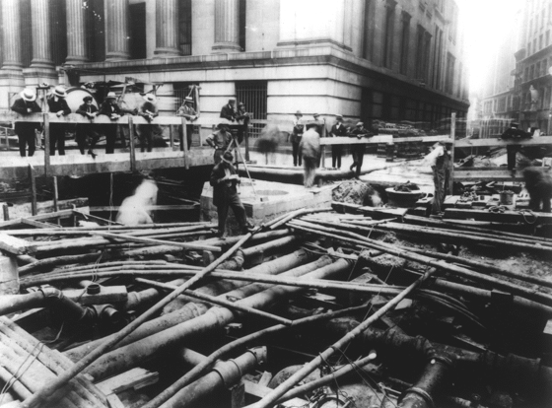
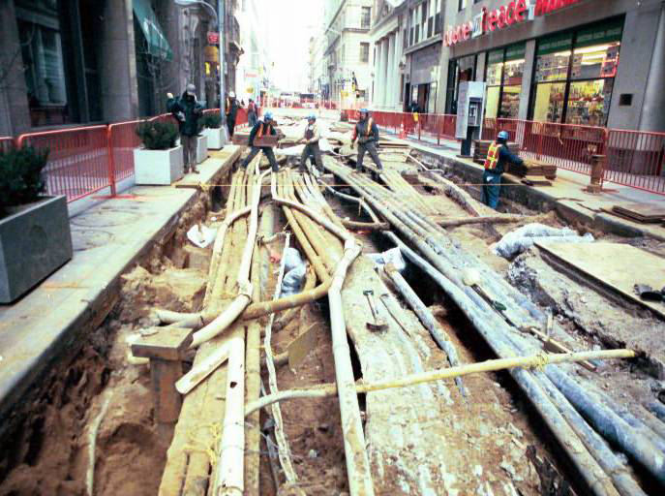
The Problem on the Ground for Smart Cities
Wall and William Streets, early 1900s
William Street near Fulton Street. 2003
Source: Con Edison, Multi-utility Tunnels, presentation document, dated March 3, 2005
Smart Cities Encounter the Roadway

Slide 11
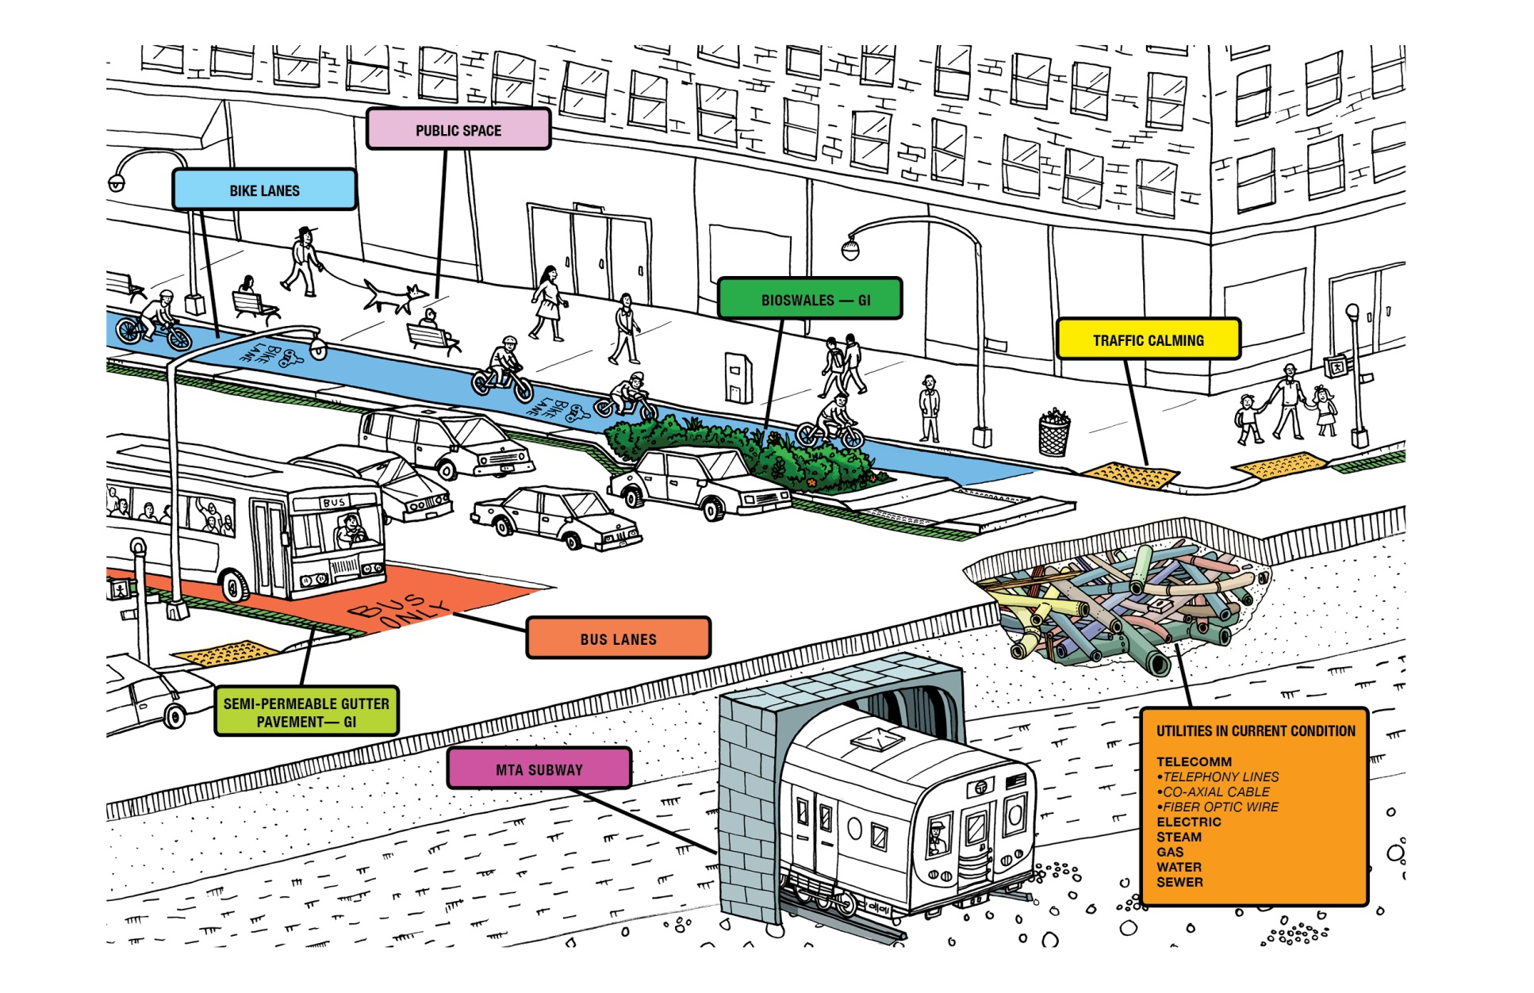
The Complete Roadway as a Complex Transportation System Above and Below
Source: David Akey, NYCDDC Creative Services
The Roadway as a Complex System

Slide 12
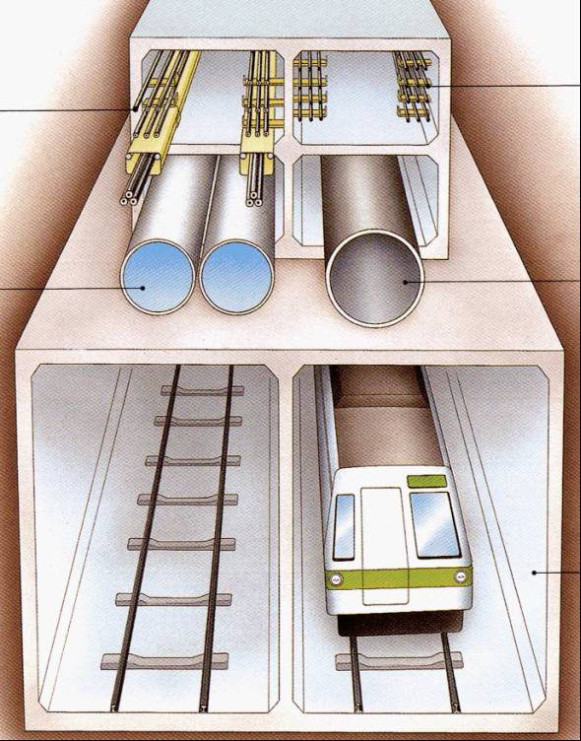
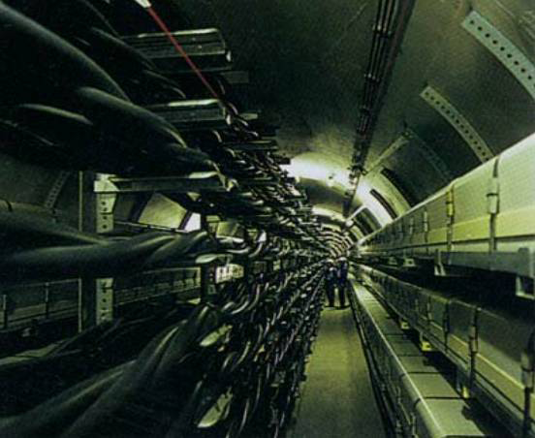
Engineering Design Solution Requires Complex Legal Analyses to Implement
Source: Con Edison, Multi-utility Tunnels, presentation document, dated March 3, 2005
Engineering Solution Requires Legal Analyses

Slide 13
Town+Gown: Action Research is Messy
2010-2011
2011-2012
2012-2013
2013-2014
2014-2015
2015-2016
Life Cycle Costing Data for Roadways Symposia Event
2/22/12
Creating Sustainable Neighborhoods
Symposia Event
4/3/12
Roadway.2—A Work in Progress Symposia Event 2/12/13
Redesigning Neighborhood Change Symposia Event 5/13/14
Roadway.3—A Work in Progress Continues
Working Group Meeting
4/23/15.
What Can Public Built Environment Data Tell Us?
Symposia Event
4/25/12
Planning Sustainable Neighborhoods
Anatomy of a Project—From District One to Microgrid
Symposia 6/18/13
Overview of the Law of Private Utility Regulation: The Law and Economics of Utility Regulation
Overview of the History
of New York State Private
Regulation Law: Regulation
of Gas, Electricity, and
Telecommunications
Overview of Rate Setting
Process in New York State: How New York Sets Rates
The Multi-Purpose Utility
Corridor Hypothetical:
Telecomm, Gas and Electric
Utility Analyses
All Brooklyn Law School
Life-cycle Cost Analysis and Green Infrastructure in New York City
Columbia/SIPA
Public Private Partnership Financing of Green Infrastructure
Columbia/SIPA
Transitioning
into Lifecycle
Cost Analysis
NYU/Wagner
Rethinking the Grid
Cornell/CRPP
Confronting the Challenges of
Microgrid Development in Post-
Hurricane Sandy New York City
Cornell/CRPP
Permit Density: Aggregate
Road Cuts from Multiple
Overlapping Contractors
(2008-2012)
Columbia/GSAPP
BLS Legal Research Set at Center

Slide 14
Town+Gown: Law Questions in the Research Agenda
Investigations into Design-Build
Unpacking “Means and Methods”: Is It a Sword or Shield or What?
False Claims Laws and Quantitative Analyses of Cost Growth in Public Works Projects
How to Apply Relational Contracting Principles to the City’s Lease Arrangements?
How to Assure a “Green” Future—Green Building Regulations and Enforcement?
What is the Relation between Land Use Law Techniques and Urban Design and Function?
Are Differences Among Statutory Definitions of the Construction Project Explanatory?
What Types of Construction Contract Provisions Would Increase Alignment between Principal and Agent?
For the Research Agenda Go To: http://www1.nyc.gov/site/ddc/about/town-gown.page
Research Agenda/Law

